Slide 1
Academy Award Prediction
CZ1016 Mini-Project
Chang Heen Sunn, Ooi Wei Chern, Saw William Joseph

Slide 2
Project Summary
Motivation
To discover the underlying features that determine an Oscar winning movie and predict winners for the Best Picture Award.
Problem Statements
What are the key features of a film to win the Academy Award?
Which prediction model perform best with our dataset?
Type of Problem
Classification type. To determine whether the movie is a winner.

Slide 3
Table of Contents
01
04
02
05
03
06
The Opening
Machine Learning
Why Oscars?
Best Model of the Night
Data Collection
Predict Winners
Web Scraping and Data Cleaning
The Winner is …
Data Exploration
Conclusion
Standout Features of the Winners
Wins and losses

Slide 4
The Opening
01
Why Oscars?

Slide 5
The Academy Awards,
Oscars
The Academy Award is the oldest and biggest entertainment awards ceremony in the world.
Movie makers and fans, are equally thrilled with anticipation to see their favorite movies lift the biggest award at the end of the night: The Best Picture Award.

Slide 6

Data Collection
02
Through Web Scraping
Using BeautifulSoup
… …
& manual filling

Slide 7





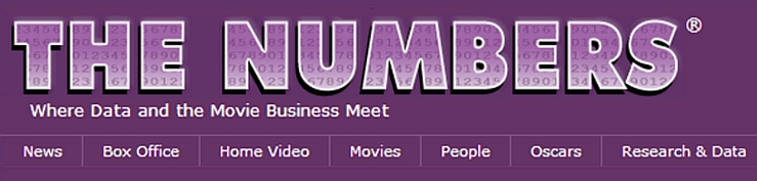

Slide 8
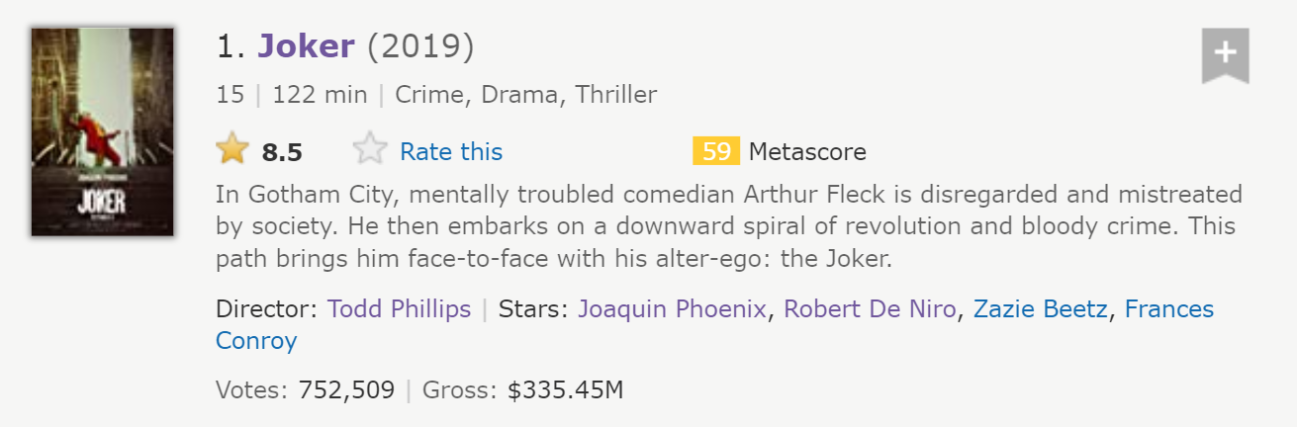
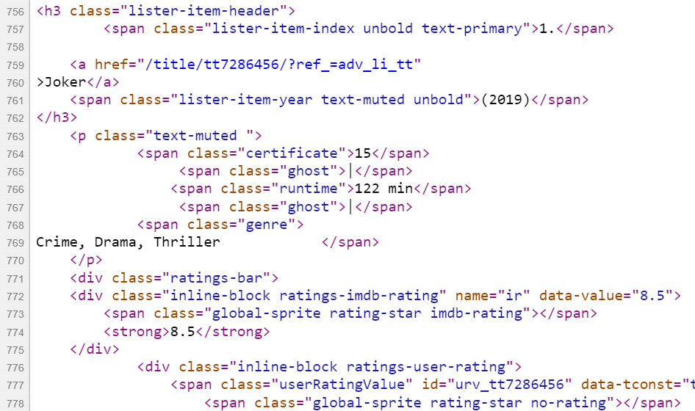
Movie name
Genre
IMDb rating

Slide 9
Data Scraped
Box Mojo
For checking
IMDb / Metacritic | Rotten Tomatoes
General info User rating Number of votes *Metascore | Tomatometer Number of reviews
The Numbers | Wikipedia
Budget Domestic (US) gross International gross Worldwide gross | Film awards winner Film awards nominations

Slide 10
128,100
2,100
data collected in total
movies scraped from online sources
53
features formed and collected
We scraped through,
2100 x 61 columns
1999-2019

Slide 11

Manual Filling, Cleaning & Checking
# 1. Movies naming format different
Stemming & Lemmatization
Movie name consists of different languages, weird symbols
Examples: (2001) Sen to Chihiro no kamikakushi -Spirited Away (2002) AstÃ©rix & ObÃ©lix: Mission ClÃ©opÃ¢tre - Asterix & Obelix: Mission Cleopatre

Slide 12
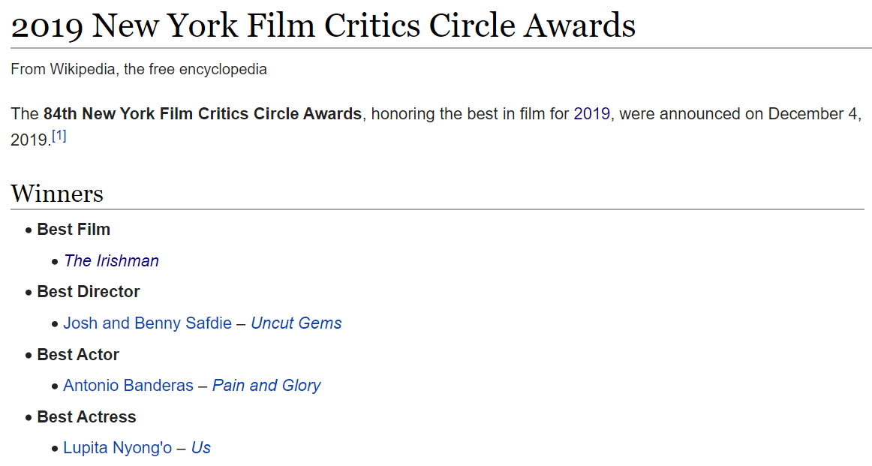
Manual Filling, Cleaning & Checking
# 2. More Efficient
Wikipedia table
Need to check manually nevertheless

Slide 13
03
Data Exploration & Analysis

Slide 14
Category of Features Collected
01
02
03
04
Ratings
Movie Elements
IMDb, Tomatometer & Metacritic
Genre, Runtime
Commercial
Film Awards
Box office & Budget
International Awards (BAFTA, DGA, PGA, etc.)

Slide 15
What Features Show A Good Movie?
Critical Ratings
Awards Correlation
IMDb User Rating, Tomatometer and Metascore all good indicators to tell which movies are Oscar-worthy.
Awards ceremonies have one thing in common: Good eye for appraising movies.

Slide 16
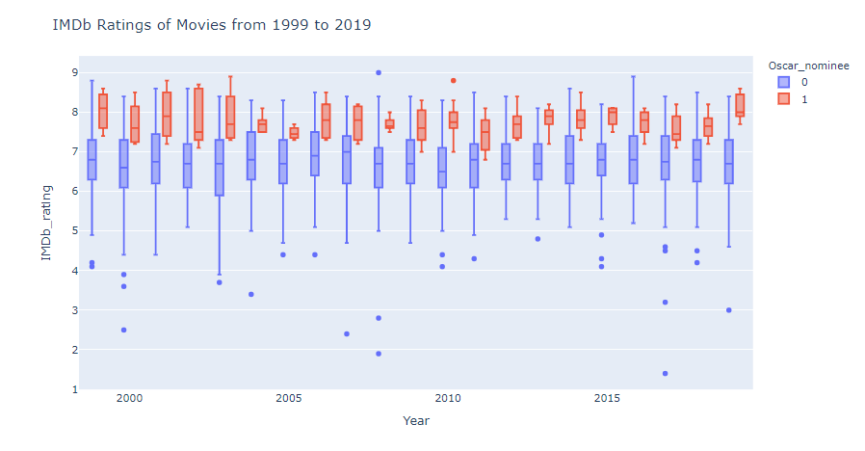
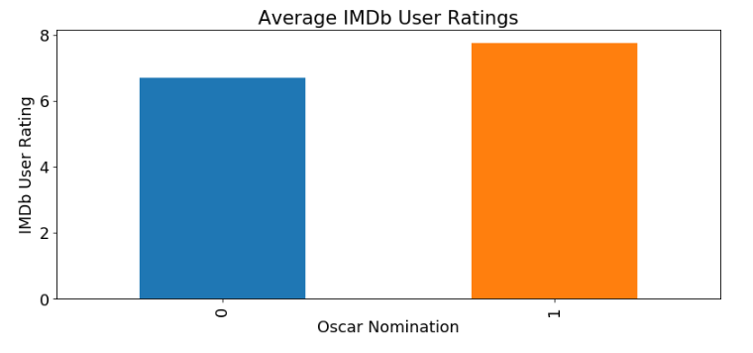
IMDb Rating
Boxplot
Barchart of Average

Slide 17
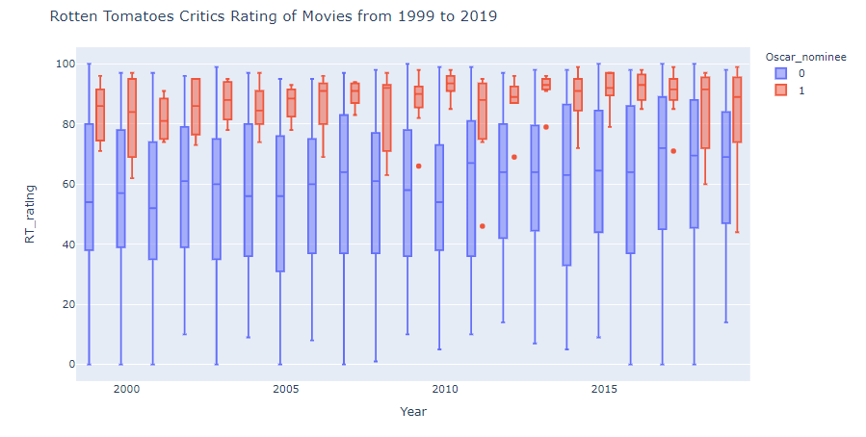
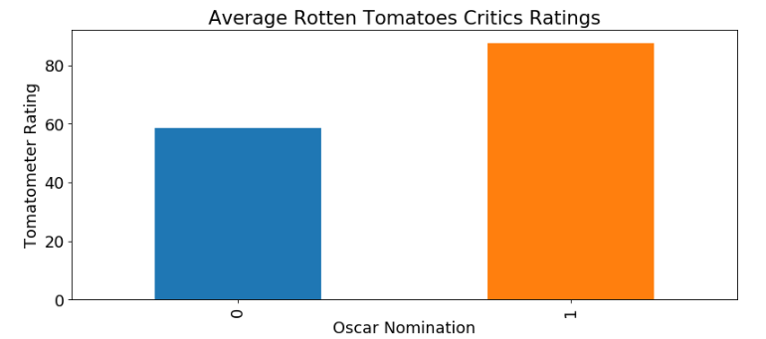
Tomatometer
Boxplot
Barchart of Average

Slide 18
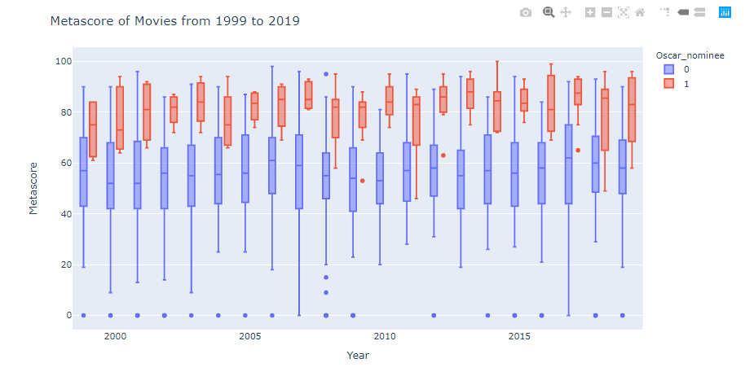
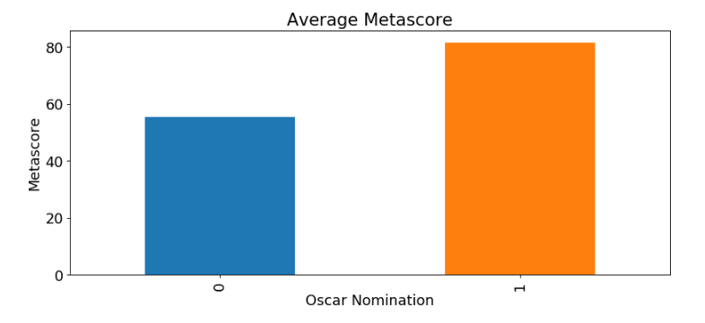
Metascore
Boxplot
Barchart of Average

Slide 19
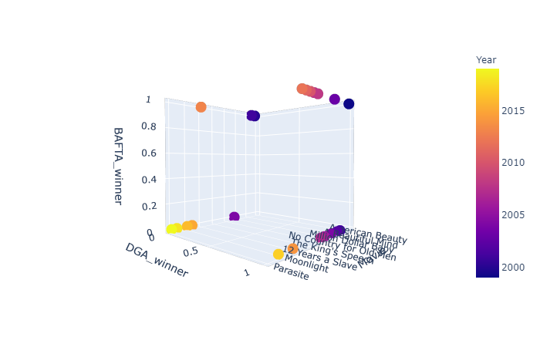
3D plot to correlate DGA, BAFTA with Oscars
Correlation Between Awards
DGA shows better correlation with Oscars than BAFTA.

Slide 20
Correlation Between Awards
 | Oscar Win | Oscar Nomination
Director’s Guild Award (DGA) | +0.65 | +0.76
Producer Guild Award (PGA) | +0.63 | +0.77
Golden Globes Movie Award | +0.37 | +0.63
Critics Choice Movie Award | +0.66 | +0.76
British Academy of Film and Television Arts (BAFTA) | +0.46 | +0.67
Awards and nomination with correlation above +0.60 are taken as feature for machine learning

Slide 21
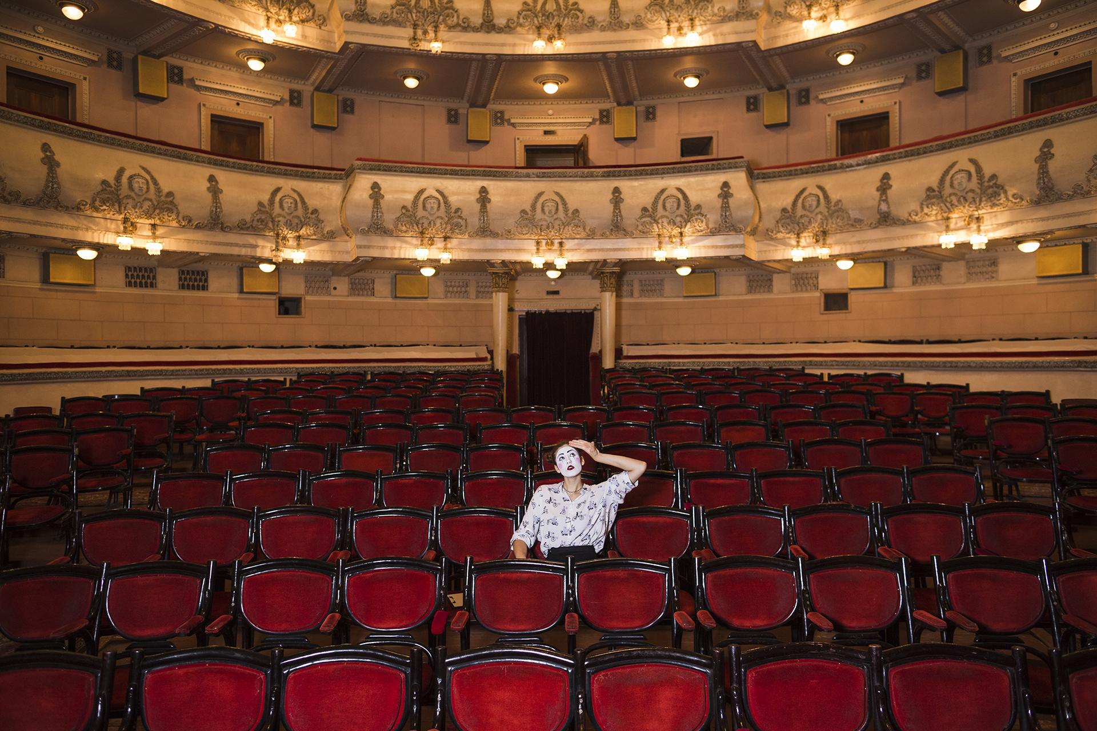
04
Machine Learning Prediction Models

Slide 22
The Classification Accuracy is a Joke
2100 movies, 21 winners (2100:21 = 100:1)
Classic problem with imbalanced data
Easily 99% accuracy rate
True Positive rate, a.k.a recall

Slide 23
The Models
1. Multinomial Naive Bayes
2. Gaussian Naive Bayes
3. Bernoulli Naive Bayes
4. Decision Tree
5. Support Vector Classifier
6. Random Forest
7. Logistic Regression
8. AdaBoost with MultinomialNB as base estimator
9. AdaBoost with Decision Tree as base estimator
10. AdaBoost with SVC as base estimator

Slide 24
Our Top 3 Models

Slide 25
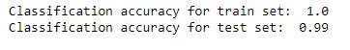
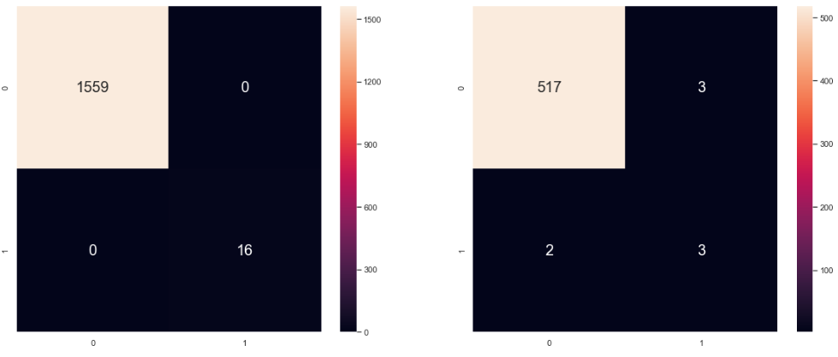
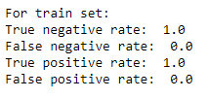
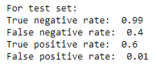
3. Decision Tree Classifier

Slide 26
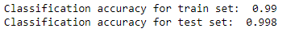
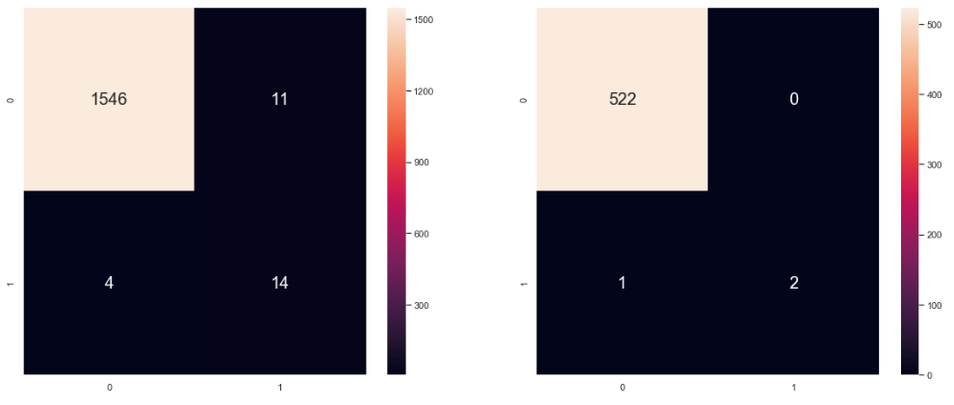
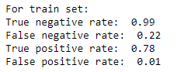
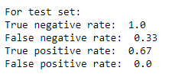
2. AdaBoost(base_estimator = SVC)

Slide 27
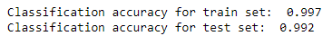
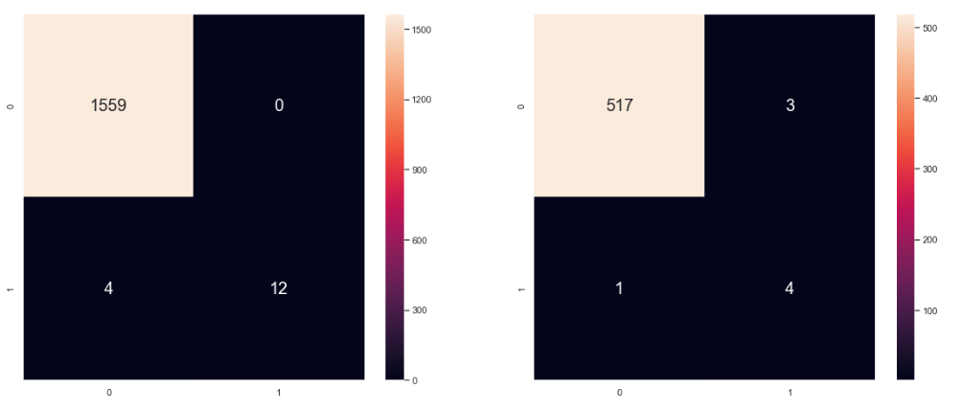
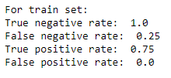
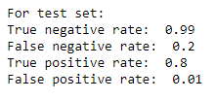
1. Random Forest

Slide 28
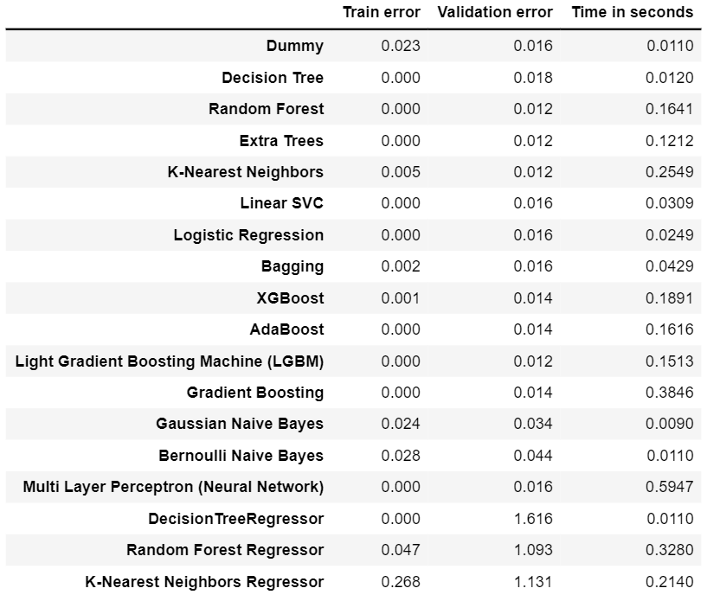
Comparing Prediction Models

Slide 29
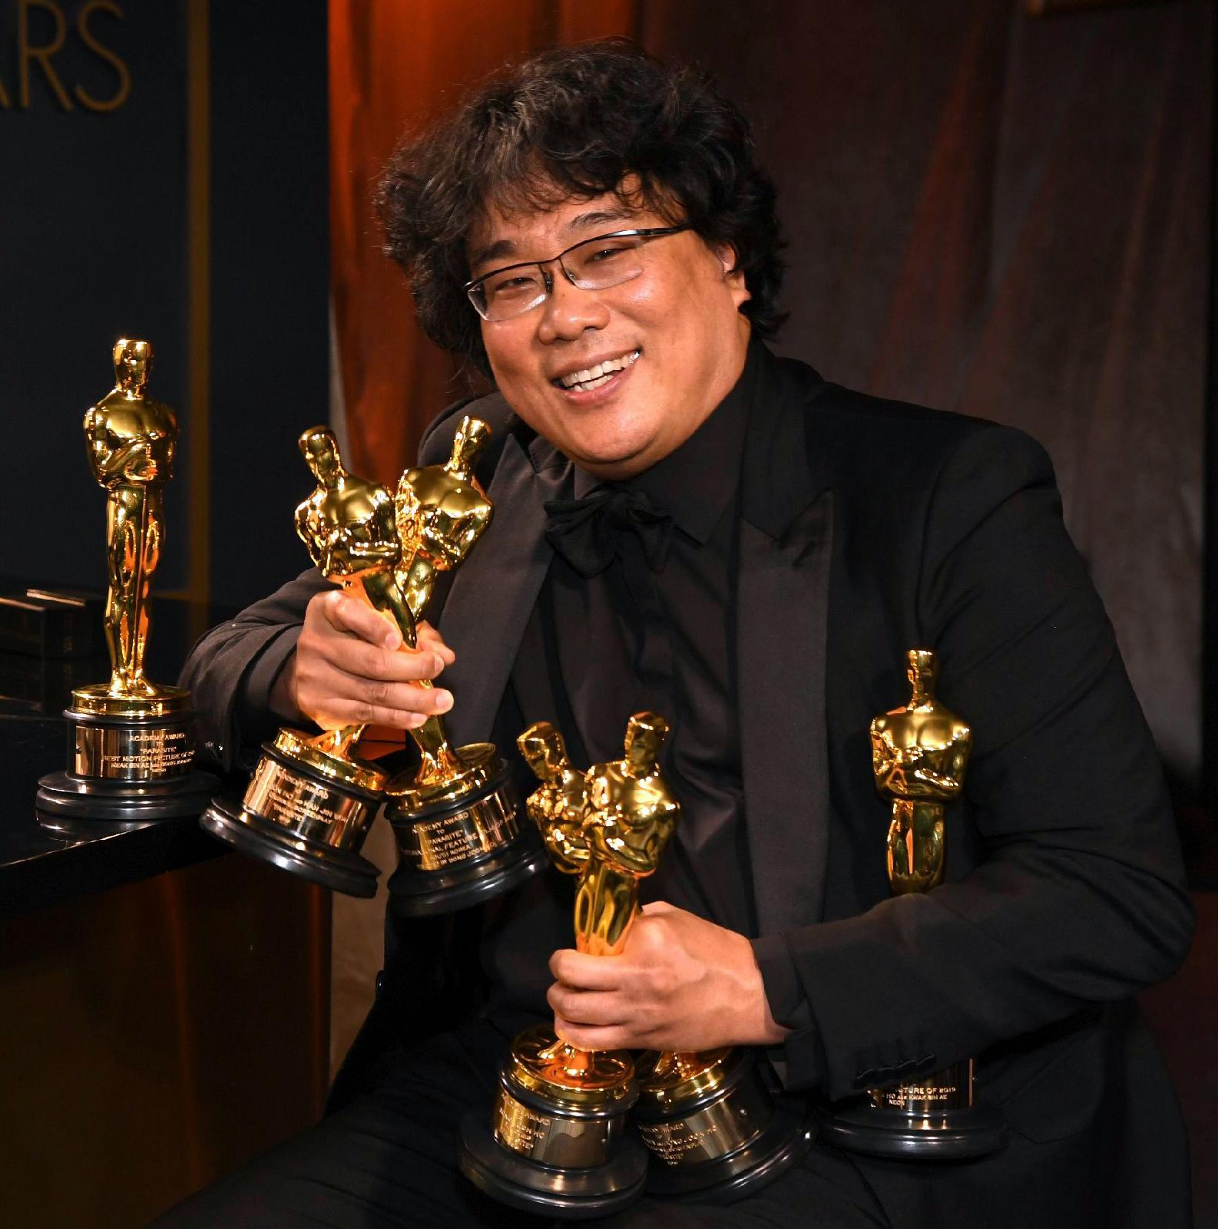
05
Predict Winners
Extremely Randomized Trees
vs.
Random Forest

Slide 30
Top 2 Features Categories
Critical Ratings
Film Awards
IMDb ratings & votes
Rotten Tomatoes tomatometer & reviews
Metascore
Golden Palm
Golden Bear
Golden Lion
PCA
NYFCC
OFCS
BAFTA
DGA
PGA
CCMA
GG_drama
GG_comedy

Slide 31
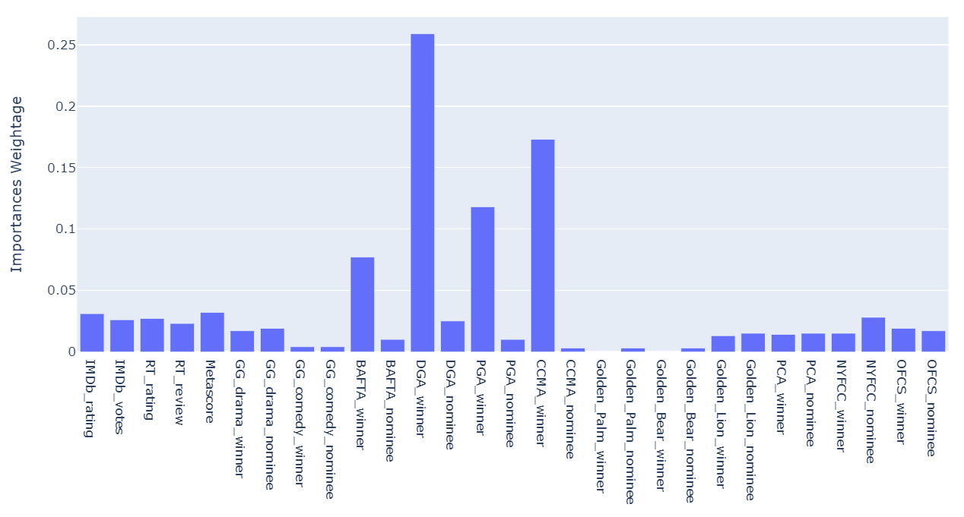
Importance of Features (Movie Critics + Film Awards)

Slide 32



Top 3 Important Individual Features

Slide 33
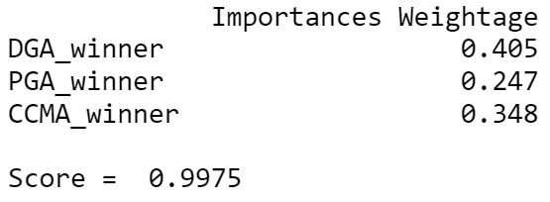
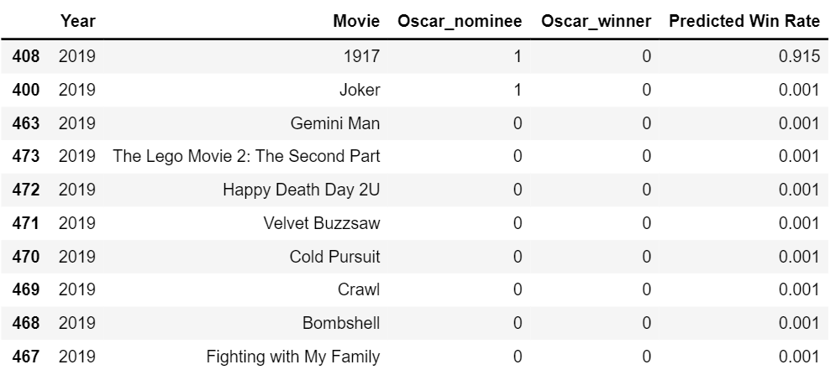
If we only consider the 3 most important features in the algorithm...

Slide 34
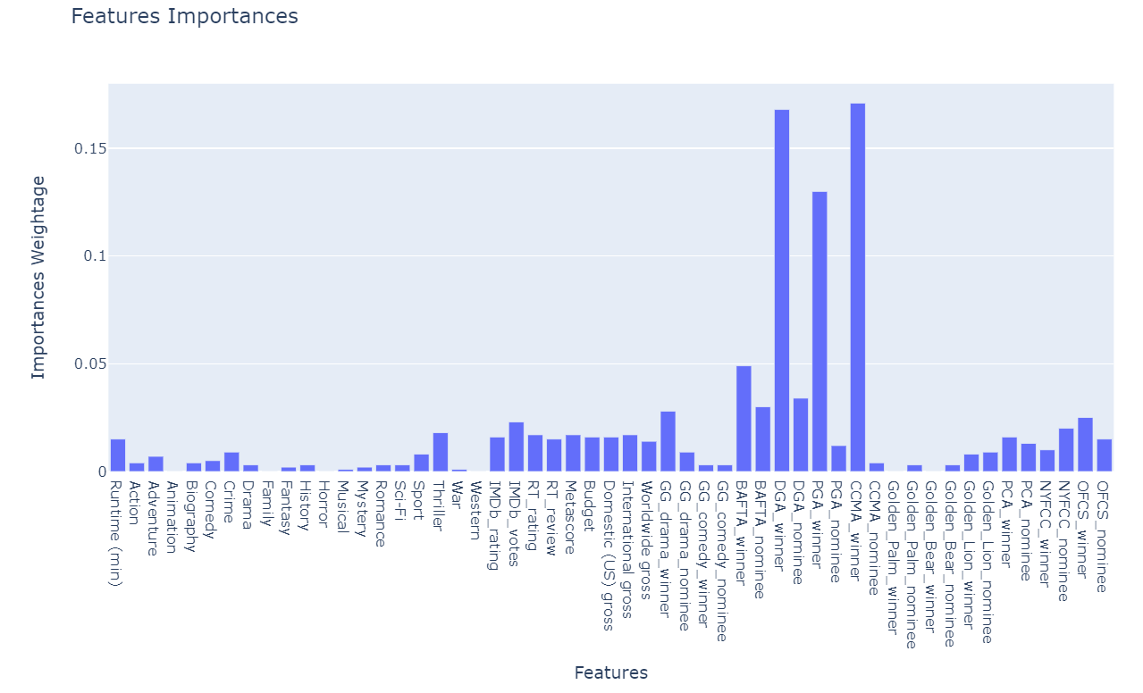
Importance of Features (All 53 features)

Slide 35
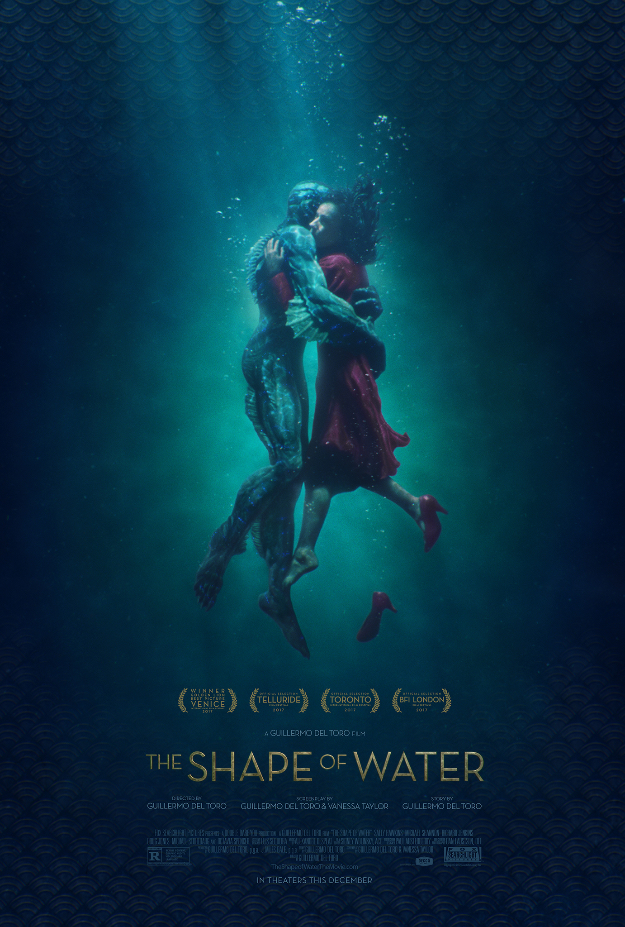
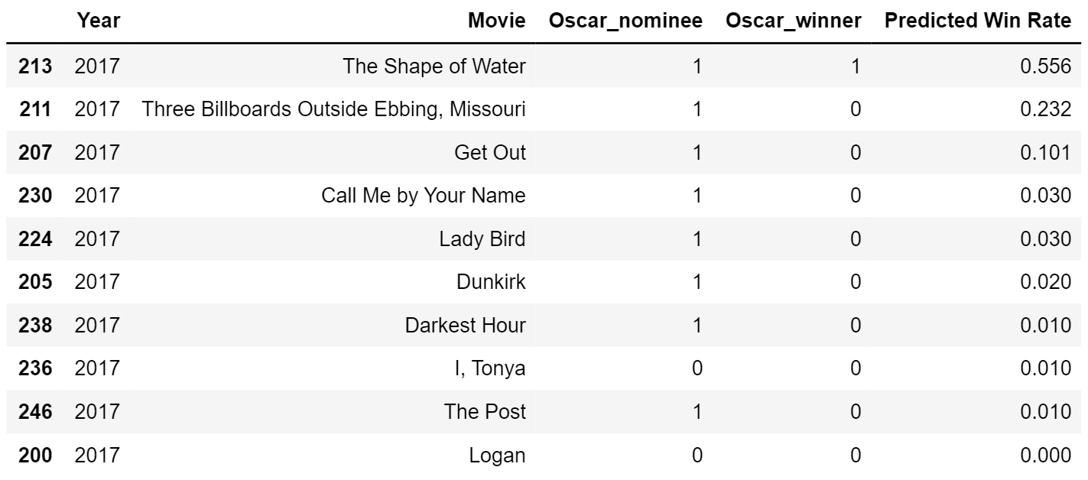
Prediction for 2017
The predicted winner wins!

Slide 36
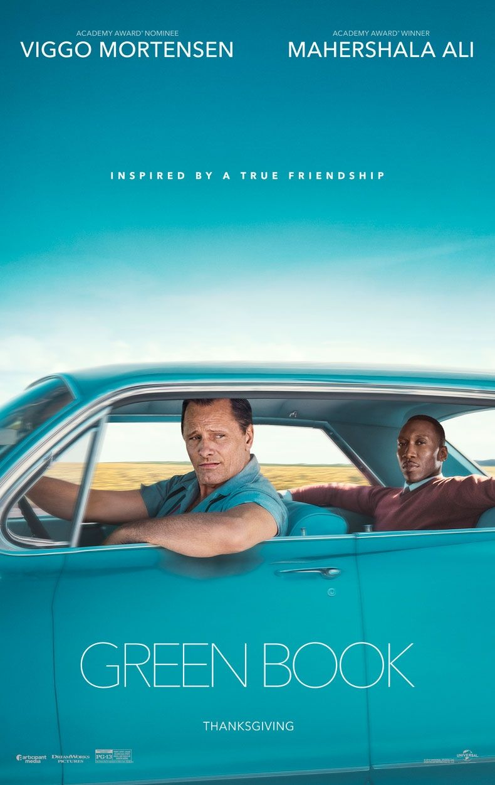
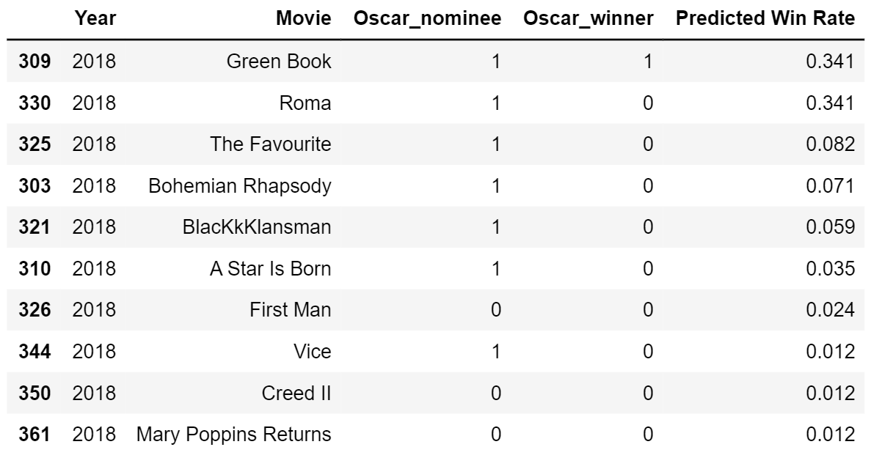
Prediction for 2018
The predicted winner wins!

Slide 37
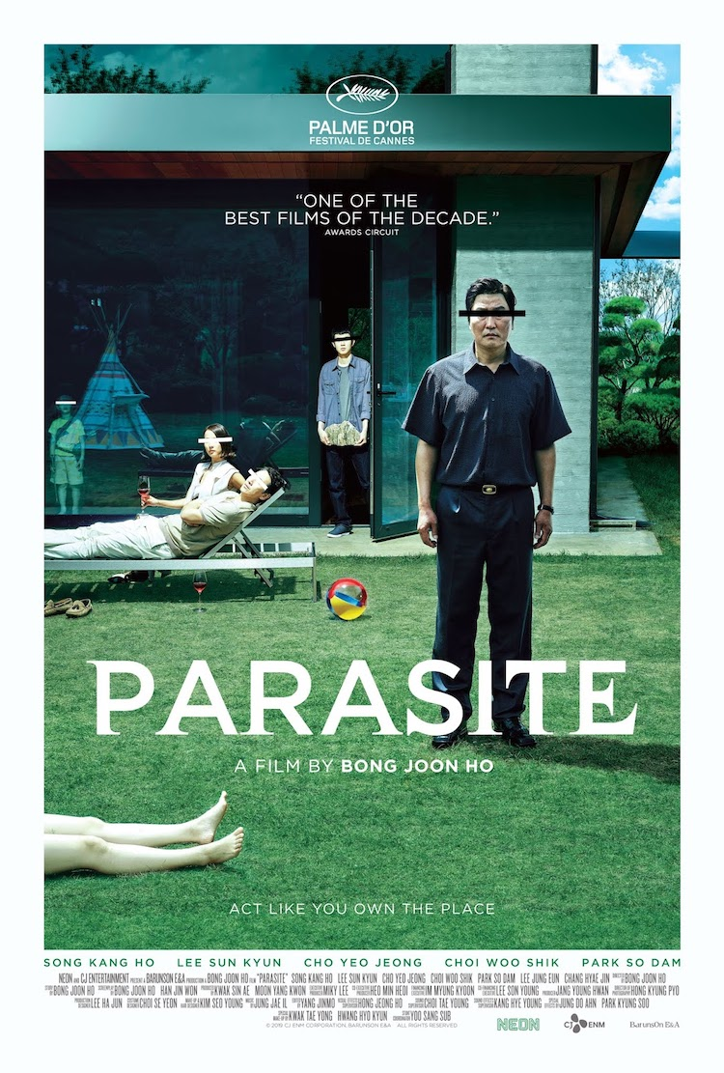
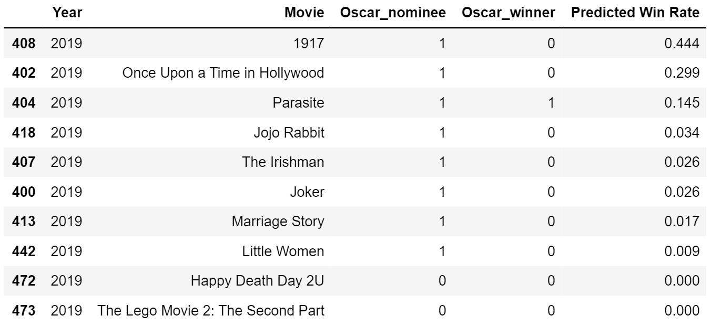
Prediction for 2019
The actual winner, Parasite came 3rd.

Slide 38
 |  | Random Forest |  | Extra Tree
 | Actual Oscar Winner | Predicted placing | Predicted Oscar Winner | Predicted placing | Predicted Oscar Winner
2015 | Spotlight | 2nd | The Revenant | 2nd | The Revenant
2016 | Moonlight | 2nd | La La Land | 3rd | La La Land
2017 | The Shape of Water | 1st | The Shape of Water | 1st | The Shape of Water
2018 | Green Book | 2nd | Roma | 1st | Green Book
2019 | Parasite | 3rd | 1917 | 3rd | 1917

Slide 39
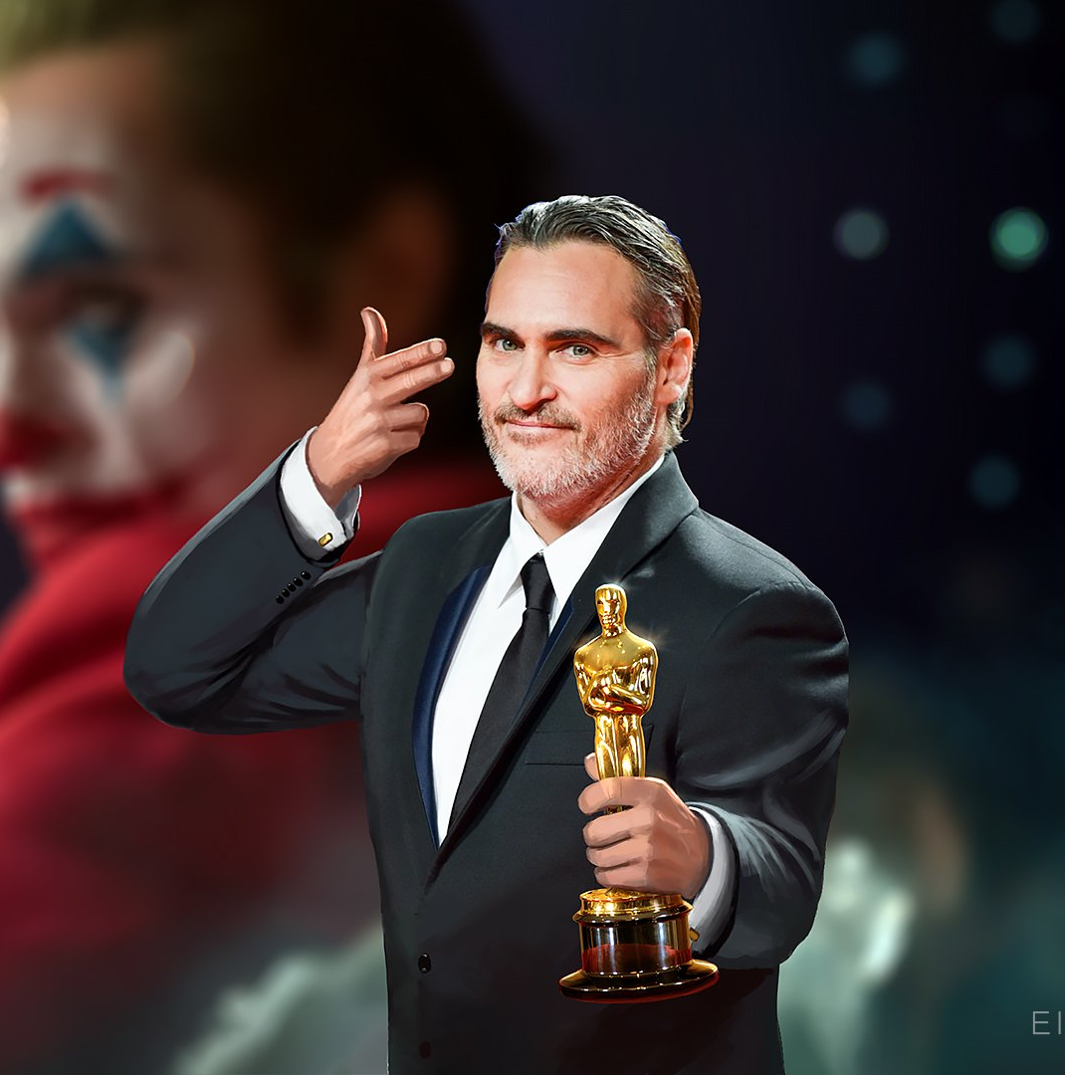
Extra
Exploration of Interest
Balloting Demo

Slide 40
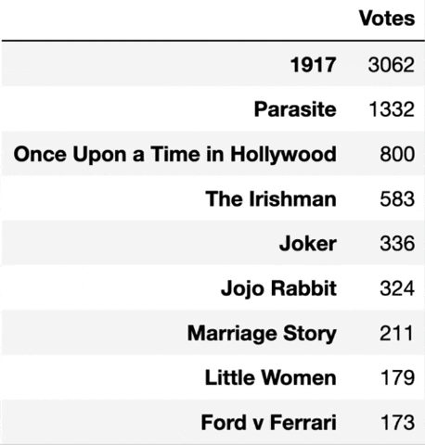
Basic idea of Balloting
simulating the Oscar academy with a voting body of 10,000 members
purpose is to pick the top 3 most probable winners for the Best Picture Award.

Slide 41
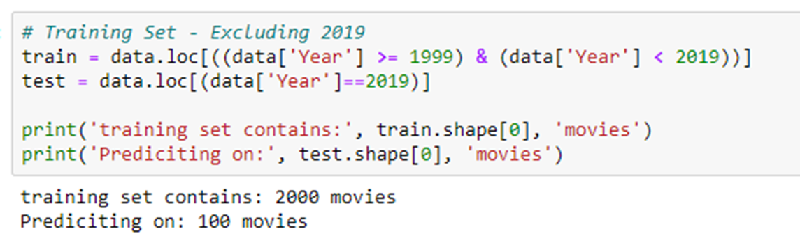
Extracting the year in prediction

Slide 42
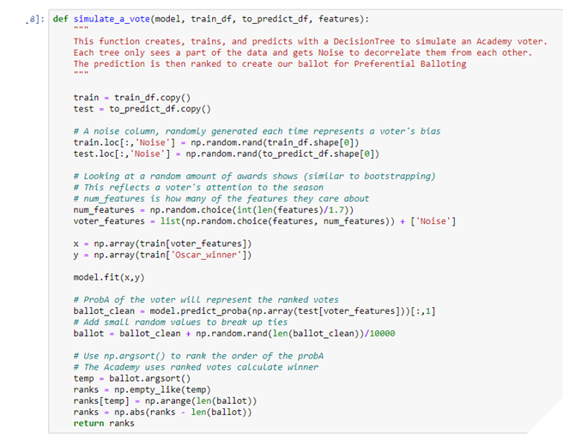
Simulating a
voter

Slide 43
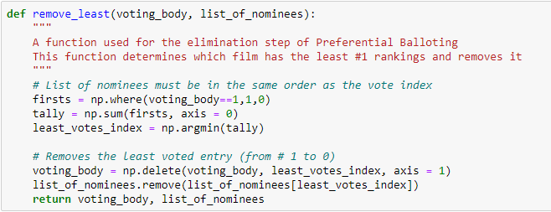
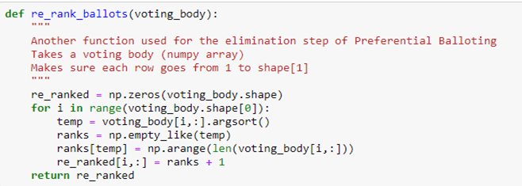
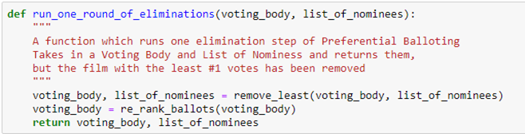
> To remove the last movie which got the least vote in the list
> To rearrange the list of movies in descending number of votes
> Voting simulation

Slide 44
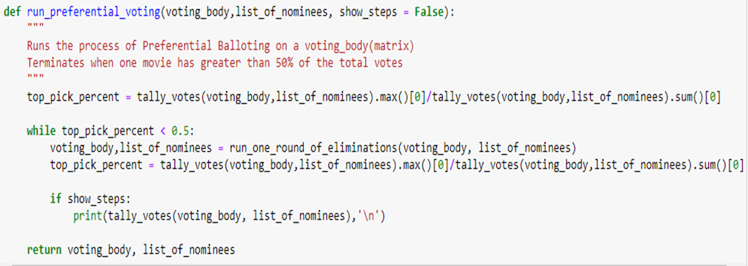
Terminates once a movie has more than 50% of votes

Slide 45
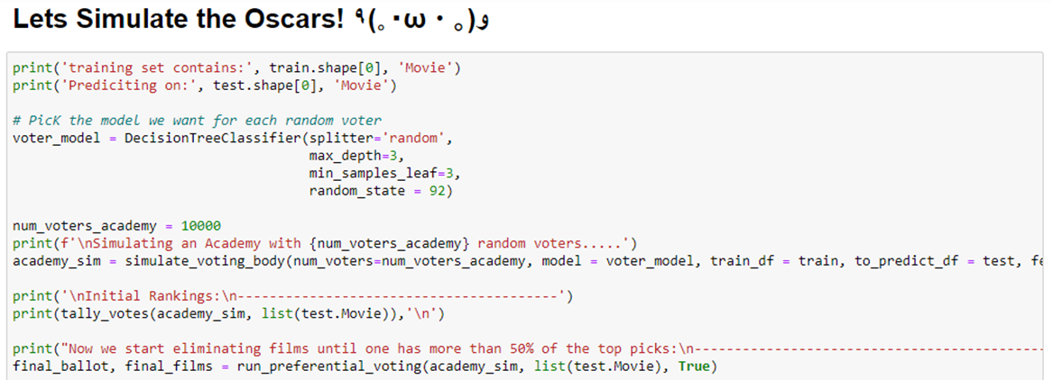
Using 10,000 voters, we ran the balloting

Slide 46
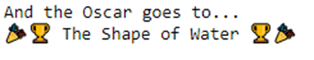
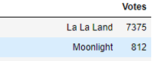
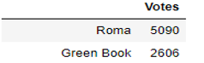
2017
2016
2018

Slide 47
Conclusion
At the end of the night …

Slide 48
Conclusion
To answer our initial problems,
Best Feature: Film Awards (susceptible to biases) and
Ratings
Best Prediction Model: Extra Tree Classifier
Our accomplishments:
Predicted two winners correctly in 2017 and 2018
Other winners in 2nd or 3rd place.
Able to replicate the results using balloting.
Additional Insight: Director strongly influences a movie’s chances at winning the awards.

Slide 49
Future Improvements
Expand our predictions to other awards.
Previous Achievements of Directors and Actors

Slide 50
Our Workflow
Data Exploration
(Wei Chern)
Data Acquisition
(Heen Sunn, William)
Predicting the Winners
(Heen Sunn)
01
02
03
04
05
06
Extras
Data Cleaning
(William)
Prediction Models
(Heen Sunn, Wei Chern, William)

Slide 51
Thanks!
Do you have any questions?

Slide 52
“I’m very enthusiastic about the Academy Award because if there weren’t Oscars, we wouldn’t have as many good movies as we have now. ”
—Robert Osborne

